Slide 1
Convergence Culture
Created by Brett Oppegaard
for Washington State University Vancouver's
CMDC 375 class, spring 2011
Notes:
1

Slide 2
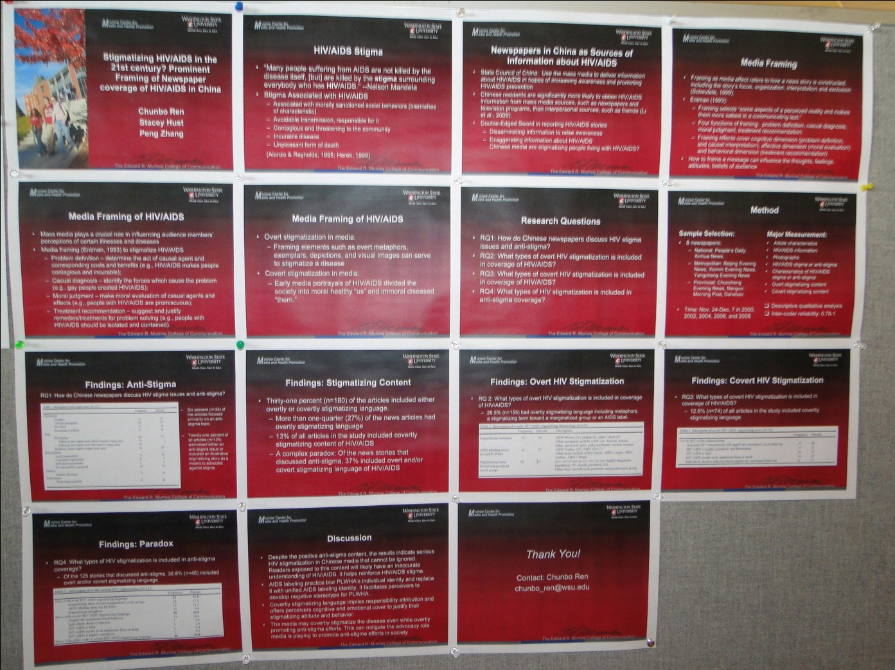
Pullman Research Showcase
Photo courtesy of Kerri Lingo
Notes:
2
Described many different ways

Slide 3
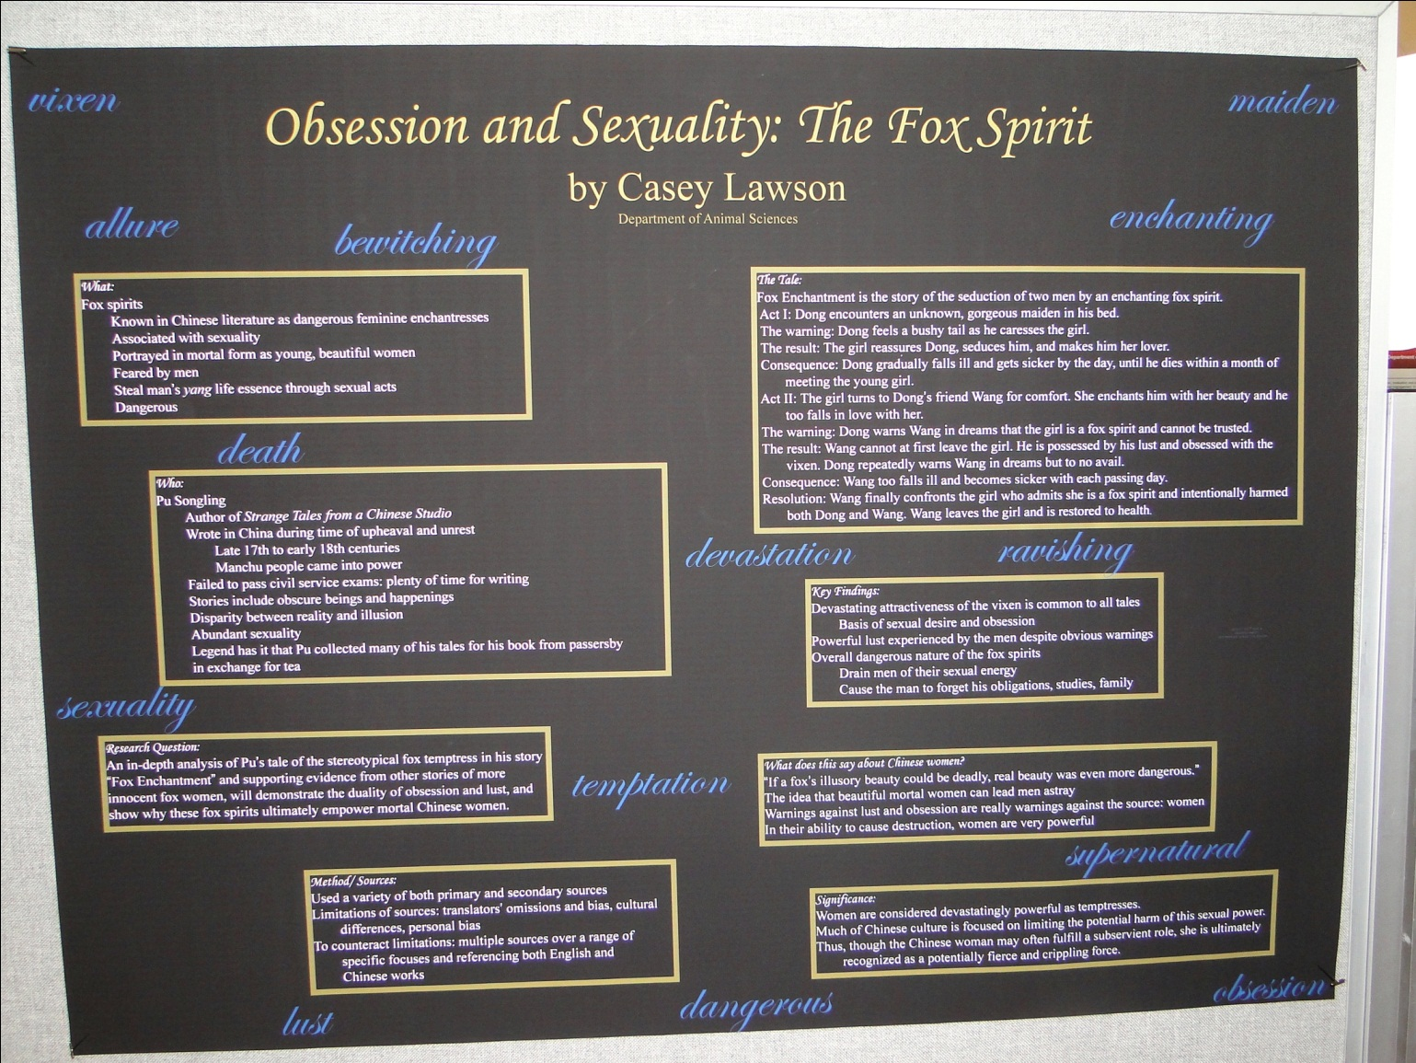
Pullman Research Showcase
Photo courtesy of Kerri Lingo
Notes:
3
Described many different ways

Slide 4
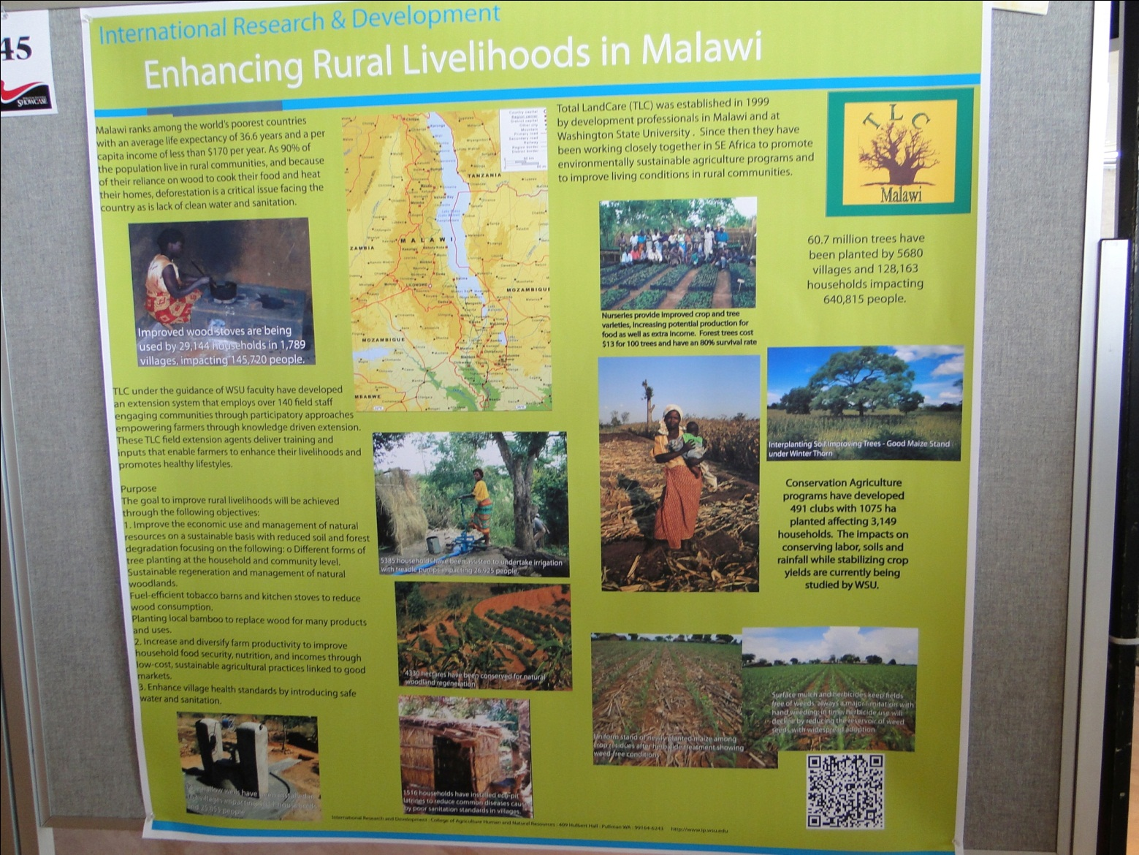
Pullman Research Showcase
Photo courtesy of Kerri Lingo
Notes:
4
Described many different ways

Slide 5
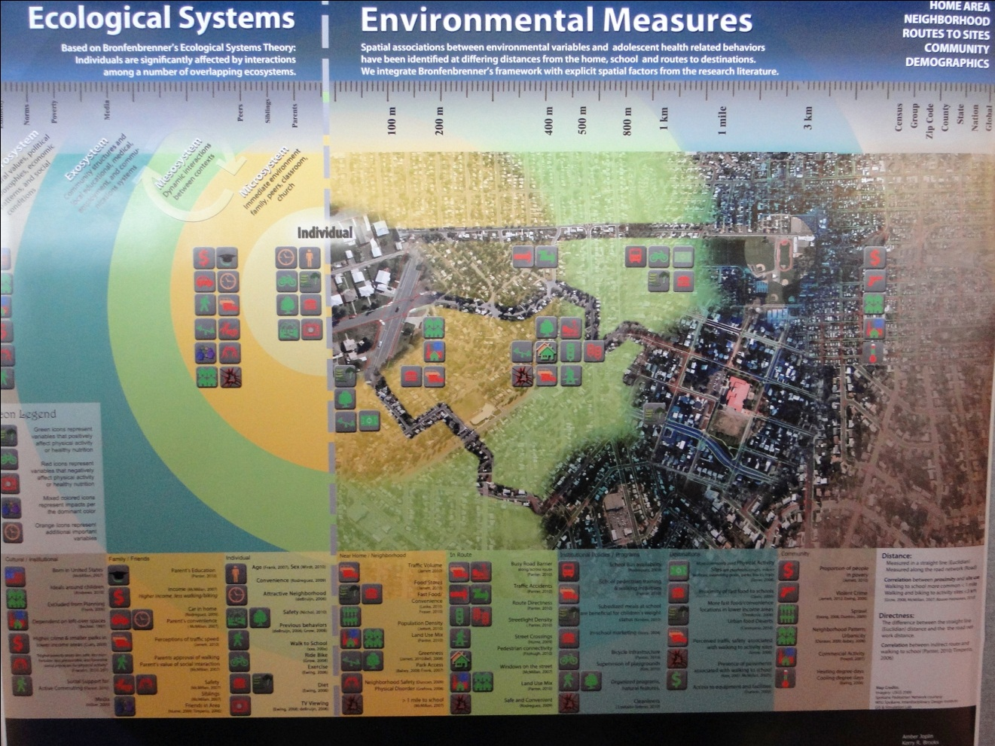
Pullman Research Showcase
Photo courtesy of Kerri Lingo
Notes:
5
Described many different ways

Slide 6
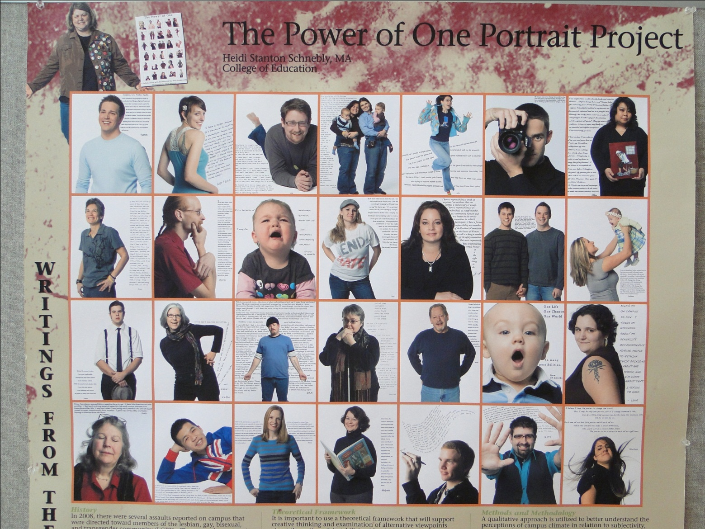
Pullman Research Showcase
Photo courtesy of Kerri Lingo
Notes:
6
Described many different ways

Slide 7
Pullman Research Showcase
Photo courtesy of Kerri Lingo
Notes:
7
Described many different ways

Slide 8
Pullman Research Showcase
Photo courtesy of Kerri Lingo
Notes:
8
Described many different ways

Slide 9
“Convergence Culture” by Jenkins
What is convergence?
Broadly describes technological, industrial, cultural and social changes in the ways media circulates within our culture.
Notes:
9
Described many different ways

Slide 10
“Convergence Culture” by Jenkins
What is transmedia storytelling?
Stories, like “The Matrix” that unfold across multiple media platforms, with each medium making distinctive contributions to our understanding of the world.
Notes:
10
Described many different ways

Slide 11
“Convergence Culture” by Jenkins
Why has transmedia storytelling emerged?
What are the downsides of it?
Does the entry point affect the experience?
Notes:
11
Described many different ways

Slide 12
“Convergence Culture” by Jenkins
What is participatory culture?
A culture in which fans and other consumers are invited to actively participate in the creation and circulation of new content, such as fan fiction.
Notes:
12
Described many different ways

Slide 13
“Convergence Culture” by Jenkins
What is collective intelligence?
Pierre Levy's term that refers to the ability of virtual communities to leverage the knowledge and expertise of their members, often through large-scale collaboration and deliberation. Collective knowledge, therefore, is the sum total of that information, which can be accessed in response to a specific question.
Notes:
13
Described many different ways

Slide 14
“Convergence Culture” by Jenkins
More on collective intelligence by Levy ...
The “distinction between authors and readers, producers and spectators, creators and interpreters will blend” to form a “circuit” of expression, with each participant working to “sustain the activity” of the others.
Notes:
14
Described many different ways

Slide 15
“Convergence Culture” by Jenkins
What is hypersociability?
A design technique that encourages various forms of participation and social interaction among consumers, including peer-to-peer information sharing.
Notes:
15
Described many different ways

