Slide 1
Sampling
Nuances of sample size determination
Brett Oppegaard, Washington State University Vancouver
Language, Texts and Technology, Spring 2011

Slide 2
Literary digest presidential predictions
Literary Digest was a popular weekly news magazine that by the mid-1930s boasted a circulation of more than 1 million readers
Every four years, Literary Digest conducted a presidential poll. It correctly predicted the winner in its first straw poll, 1916, and then subsequent polls in 1920, 1924, 1928 and 1932, all correctly picking the winner. In 1932, the result of the election was within 1 percent or the prediction. But even then, there were some critics of the Literary Digest’s methodology, so the magazine decided to amp up the effort.

Slide 3
1936 Presidential poll
Literary Digest’s methods in this poll were to:
Send out a postcard survey to as much of the nation that could be reached by mail: 10 million surveys were sent, to a quarter of the nation (with an incredible return rate of 2.3 million ballots). Gallup, by comparison, surveyed 50,000 people that year.
Squire, P. (1988). Why the 1936 literary digest poll failed. Public Opinion Quarterly, 52(1), 125-133.

Slide 4
1936 Presidential poll
Surveys were mailed to:
Everyone with an automobile registration
Everyone listed in a telephone book
Some small and even medium-sized towns reported nearly complete coverage, with all registered voters responding.

Slide 5
1936 Presidential poll
From the article touting the results:
“Now, are the figures in this poll correct? In answer to this question we will simply refer to a telegram we sent to a young man in Massachusetts the other day answer to his challenge to us to wager 100,000 on the accuracy of our Poll. We wired him as follows:
For nearly a quarter century, we have been taking Polls of the voters in the forty-eight States, and especially in Presidential years, and we have always merely mailed the ballots, counted and recorded those returned and let the people of the Nation draw their conclusions as to our accuracy. So far, we have been right in every Poll. Will we be right in the current Poll? That, as Mrs. Roosevelt said concerning the President’s reelection, is in the ‘lap of the gods.’”

Slide 6
1936 Presidential poll
Literary Digest claimed that the ballots were not weighted, adjusted, nor interpreted, and the results were stunning clear:
With such overwhelming data, it is apparent that the next
president of the United States will be:

Slide 7
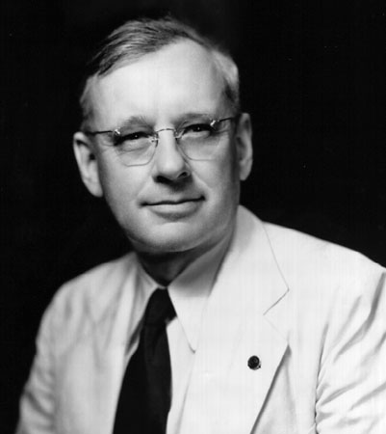
1936 Presidential poll
Alf Landon, with 55 percent of the vote

Slide 8
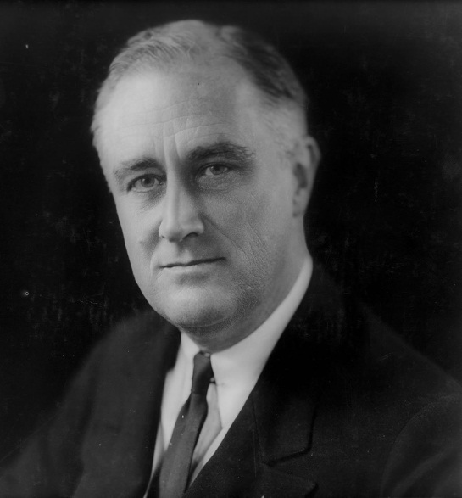
1936 Presidential poll
Franklin D. Roosevelt will get: 41 percent

Slide 9
1936 Presidential poll
FDR actually received: 61 percent

Slide 10
1936 Presidential poll
Alf Landon received: 41 percent

Slide 11
1936 Presidential poll
What went wrong?
The response rate (25 percent) was way too low, creating a large possibility (75 percent were not polled) of a non-response bias.

Slide 12
Sampling error
What happened to Literary Digest is called a sampling error (and that was a big one; the magazine closed shortly afterward because of the mistake).
The larger the sample of your population (100 percent is a census) the lower the sampling error.

Slide 13
Sampling error
As part of the mathematics involved, as the variance of the population increases, the sample size needs to increase as well.
You can get a lower sampling error, higher reliability and increased confidence in your results (all technical distinctions), but those come at a cost of more time, money and effort.
Alreck, P. L., & Settle, R. B. (1995). The survey research handbook: Guidelines and strategies for conducting a survey. New York: Irwin Professional Publishing.

Slide 14
Sampling frame
To select your sample, first identify the population you are studying.
Then, you must develop a list of the people in that population, from which you will draw.
Frey, L., Botan, C., & Kreps, G. (2000). Investigating communication: An introduction to research methods: Allyn and Bacon, Boston.

Slide 15
Sampling frame
Once you have the list, you need to decide how you will pick the people:
Random sampling (also called probability sampling) methods create ways in which everyone within the pool has an equal chance of being selected. That is the preferred approach.
Frey, L., Botan, C., & Kreps, G. (2000). Investigating communication: An introduction to research methods: Allyn and Bacon, Boston.

Slide 16
Sampling frame
Once you have the list, you need to decide how you will pick the people:
Cluster sampling methods select respondents on a random sampling of criteria; a national sample might first randomly pick a state, then a county, then a city, then a block, then a house, then a person
Frey, L., Botan, C., & Kreps, G. (2000). Investigating communication: An introduction to research methods: Allyn and Bacon, Boston.

Slide 17
Sampling frame
Once you have the list, you need to decide how you will pick the people:
Nonprobability sampling is used when a target population cannot be determined in whole or in clusters. Literary Digest used a “volunteer” sample, people who chose to respond. A convenience sample could be this class roster.
Frey, L., Botan, C., & Kreps, G. (2000). Investigating communication: An introduction to research methods: Allyn and Bacon, Boston.

Slide 18
Rules of thumbs
Sample sizes smaller than 30 and larger than 1,000 generally are not allowable or necessary
100 is a rough starting point for large populations; when in doubt, aim for 10 percent of the population
Alreck, P. L., & Settle, R. B. (1995). The survey research handbook: Guidelines and strategies for conducting a survey. New York: Irwin Professional Publishing.

